Slide 1
GCP Experience

Slide 2
Some principles
If we want to have an efficient and cost effective process to develop and run applications
Need a good development environment
Need a good toolchain
API everywhere – enablement of automation
Not to mention a DevOps culture in place
Need a good infrastructure
Resiliency
Updates with no downtime
Support Canary, Blue/Green deployments
Auto-scaling
Monitoring

Slide 3
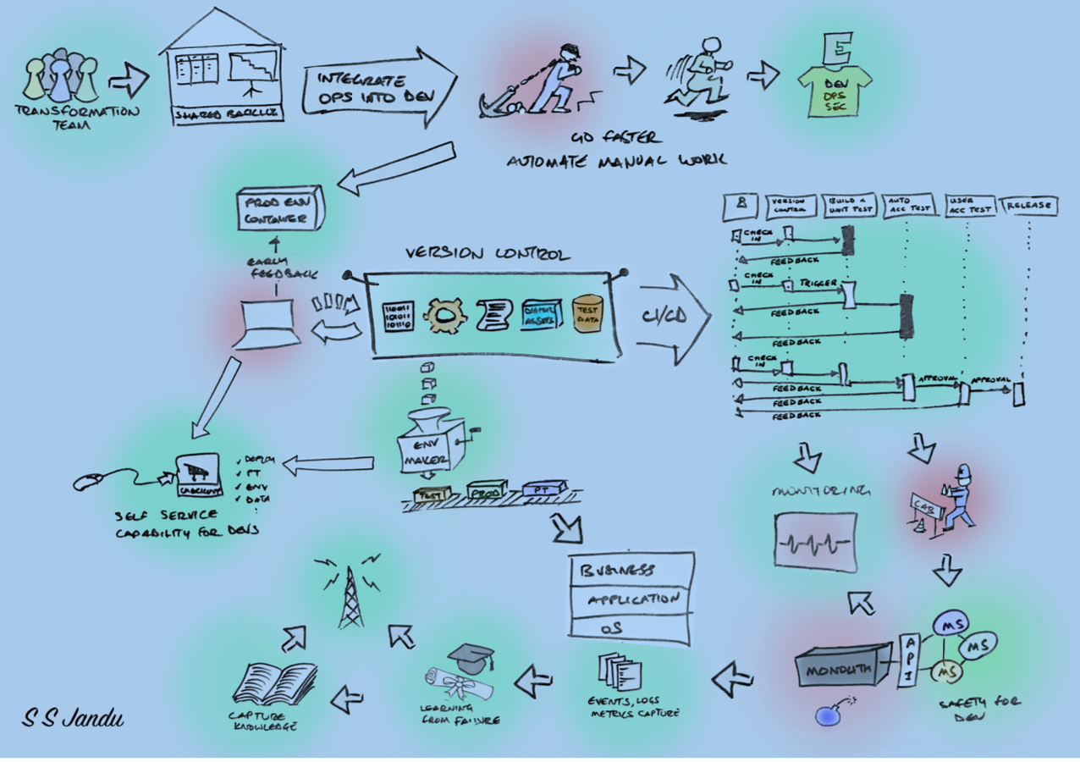
A possible “desired” environment model
Jules?
DEV

Slide 4
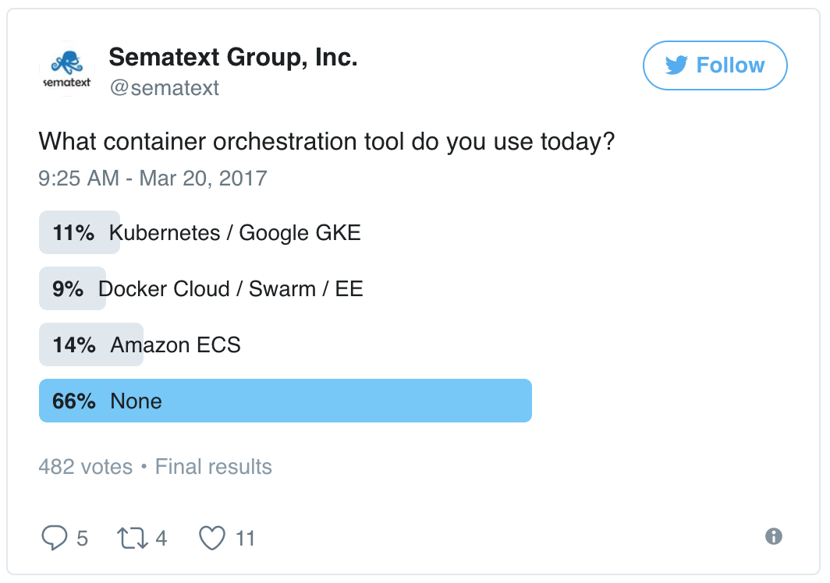
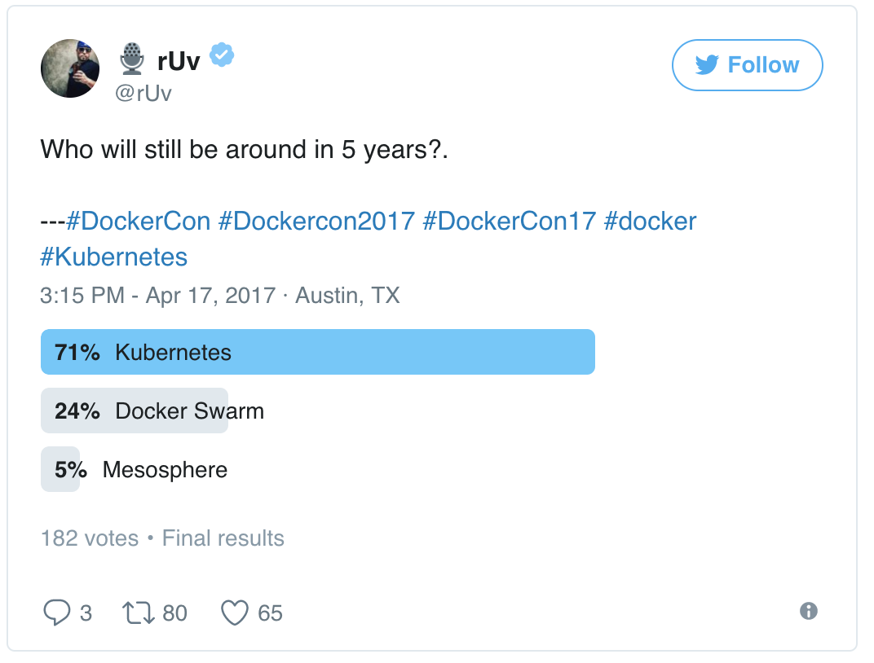
Trends on orchestration (to keep in mind)
Orchestration: automatic deployment, scaling and management of containerized applications
https://sematext.com/blog/2017/04/24/docker-orchestration-poll-kubernetes-swarm-amazon-ecs/

Slide 5
My GCP journey - services
Started as a “simple” user – manual onboarding
Got permission to create services (Basilica)
No API to interact with the MarketPlace
Initially could not use the services created, which was later made available thru GUI
To get Spark to run, needed to work with Ravi (lack of documentation, access, samples)
No HDFS local or remote, all in memory
Could not get results or logs – access provided thru mesos tasks GUI
Cannot update services
Cannot delete services
Created Kafka service, that was used later on
Spark and Kafka are the OpenSource versions, no authentication (security/authorization)

Slide 6
My GCP journey – build image
Building an image
AIM-PM tool (requested access and installed tool in windows system)
Not user friendly; Jitu provided me with a working script that I adapted
Build steps:
Write code and Dockerfile
Run scripts
Check on registry site for build status
Issues with image build process:
Could not get ”pip” to run (module manager for python)
Worked with AIM and JPMIS to get a “recipe” that worked
No access to status Quay (image registry), access thru QuayGCP GUI
Ran into a multi-page issue (bug now resolved)
Cycle to develop images and test them “too long” and debug features lacking
Got access to a lab machine where docker machine was installed
Transfer files via “python SimpleHTTPServer” – better, but not ideal
Once code and Dockerfile were working, back to the AIM-PM process

Slide 7
GCP: image build process (AIM-PM)
Comparison:
Building an image for GCP
Building an image in Docker
Script:
# Define Variables
param(
[int] $SealId = 89900, # Do not change
[string] $EntitleAdmin = "gcp-eng", # Do not change
[string] $DockerFilePath = "C:\TEMP\hwPythonEx", # Keep it
[string] $BinariesPath = "C:\TEMP\hwPythonEx", # Keep it
[string] $ImageName = "hwp_9_r623433",
[string] $QuadNameForDockerfile = "quad:/aim/testdata/hwpDocker9",
[string] $QuadVersionForDockerfile = "0.0.1",
[string] $QuadNameForBinaries = "quad:/aim/testdata/hwp9",
[string] $QuadVersionForBinaries = "bin",
[string] $EndpointName = "hwpendpoint9",
[string] $PackageName = "hwppackage9",
[string] $PackageVersion = "0.0.1",
[string] $FileGroup = "gcp-test/0.0.1",
[string] $LinkPath = "quad:/aim/testdata/deployment-api"
)
# Create Entry for Dockerfile
aim create entry $QuadNameForDockerfile --sealid $SealId
aim create entry $QuadNameForDockerfile/$QuadVersionForDockerfile --sourcepath $DockerFilePath --property type=source
# Create Entry for Binaries
aim create entry $QuadNameForBinaries --sealid $SealId
aim create entry $QuadNameForBinaries/$QuadVersionForBinaries --sourcepath $BinariesPath --property type=source
# Create Link to point to new binaries
aim update link $LinkPath --target $QuadNameForBinaries --entitleadmin $EntitleAdmin
# Update filegroup with new binaries
aim update filegroup $FileGroup --addentry $LinkPath --entitleadmin $EntitleAdmin
# aim-pm commands to create package, endpoint and deploy
aim-pm login
# Create Package
aim-pm create package $PackageName --filegroup $FileGroup --entitleadmin $EntitleAdmin
# Create Endpoint
aim-pm create endpoint $EndpointName/gcp-image --property sealid=$SealId imagename=$ImageName buildcontext=$QuadNameForDockerfile/$QuadVersionForDockerfile/Dockerfile --entitleadmin $EntitleAdmin
# Publish Package
aim-pm publish package $PackageName --version $PackageVersion
# Deploy Package
aim-pm deploy package $PackageName/$PackageVersion --endpoint $EndpointName/gcp-image
GUI
Status
BuildLogs
Dockerfile
<Code>
Docker build
Docker push (optional)
Dockerfile
<Code>
Quay: Registry

Slide 8
My GCP journey – run container
No or very limited access to DC-OS API directly
Access via GCP-API
Recently GCP-CLI became available (more on this later)
Access via GCP-API
Could deploy image and run image with curl or postman, with Janus cookies and marathon task description
A new image name is created for any change in the code or Dockerfile
This new image needs to be reflected in marathon.json
Difficult to develop anything of substance without proper access to a DEV environment
From creating a image, deploying and getting results there are too many steps with little value-add to the app itself
Got access to a lab machine where docker was installed
Transfer files via “python SimpleHTTPServer”, better but not ideal
Latest version provides gcp-cli for DEV
Simplifies the creation and deployment of images (just for DEV) – better round trip
Access to output still through url – webpage with a common user, where you have to find your task or API to download the output
No “exec” capability to introspect the container

Slide 9
GCP: container run process
Comparison:
Running a container in GCP
Running a container in Docker
curl
Postman
Post
Get
GUI
Get Logs/Output
Docker run
Marathon
json
Mesos
Quay: Registry

Slide 10
Using services from market place
Spark
Could only experiment with a trivial jar file
Output retrieved thru special account (shared with all users)
Need to locate taskId from marathon and be able to see output (stdio/error)
Kafka
Created a simple streaming application, one container producing and one consuming and presenting the stream on a web page.
Extended this application to demonstrate that a topic could be produced in GCP and consumed in GAP
This is being used in the Praestro project
No API capabilities to create and manage Kafka service

Slide 11
Customer requests
Spark
Connection to external HDFS
Local HDFS
Expose pyspark capabilities (inherent to the tool, but not exposed)
Authentication and security
Kafka
Authentication and security
Container
Use of vendor/external images (ArangoDB, Neo4J, Informatica(?))
Need to define a process
Customers would like to use containers – some need better understanding on how to use the platform
Mount of external volumes / block storage
Looking at StorageOs as a candidate
File transfer
Access data from legacy systems

Slide 12
Concluding remarks
As of now
Need a better development experience
Need to have better clarity from JPMIS regarding marketplace: is this going to be the internal offer for Kafka and Spark.
A good candidate for run vendor/external docker images and provide services
Should be “compatible” with Zeus in terms of user experience and capabilities – there should be a smooth transition in moving applications back and forth
Need to “work” with a toolchain
Need to be automation ready by exposing/creating APIs
Need to figure out performance of this platform: network, computation, storage
Need to verify HA capabilities (platform and applications)
Need to find a sweet spot for this platform

